Slide 1
ALL STAR ELOGS
--------------
ELD System
ALL STAR ELOGS solution ensures FMCSA compliance and
delivers superior safety and productivity for any fleet
https://allstarelogs.com/
ALL STARE LOGS - Electronic Logging Device

Slide 2
Main Features
ELD Compliance and much more
Automatic HOS
Automatic hours of service calculation and violation alerts.
Automatic recording of driving time ,miles and locations.
Compliance Monitoring
Monitor your driver’s hours of service log and DVIRs.
Receive alerts to prevent violations.
DOT Inspection Mode
Simply show logs on your phone or tablet.
No printer needed.
Fleet Tracking
Track your vehicle in real time and view their location history.
Electronic DVIR
Vehicle inspection reports are created and
Submitted in seconds.
Access Permission
Manage permission for fleet managers,compliance,
Officers,driers,accountants,broker and customers
Multiple HOS Rules
Compliant with multiple HOS rules including Property/Passenger 60-hour/7-day & 70-hour/8-day..
IFTA reporting
Automatic IFTA state mileage reporting saves you time and money

Slide 3



ELD Components
Things You Need To Stay Compliant
Simply plug Electronic Logging Device into a vehicle ECM port and start recording driving hours and miles automatically.
Logbook app connects to Electronic Logging Device via blue-tooth and displays recorded driving time to a driver
ELD & App work great with most tablets and smartphones. Use your own or purchase devices and data plans from us
Logging Device
Logbook App
Tablet/Smartphone

Slide 4
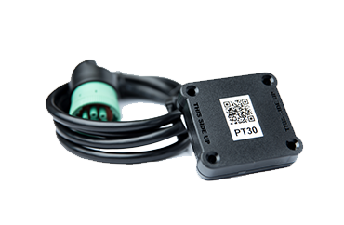
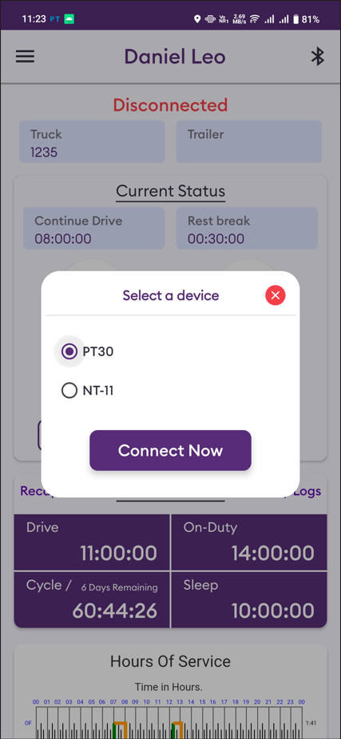
Install & Connect ELD
Elds are installed within minutes
Locate ECM (diagnostic) part
Locate ECM port inside vehicle.look for 9 pin or 6 pin circular ports in heavy duty vehicles.Look for OBDII port in light.medium duty vehicles.
Install ELD
Simply plug the provided cable into a vehicle ECM and attach the other end to the ELD device. the dual fastener is provided for dash mounting.
Log into ALL STAR ELOGS App
Log in to the app on your tablet with username and password created during a sign up process or provided by a fleet manager.
Connect ELD select a connection type from the list and your app will attempt to connect with ELD via Bluetooth.

Slide 5
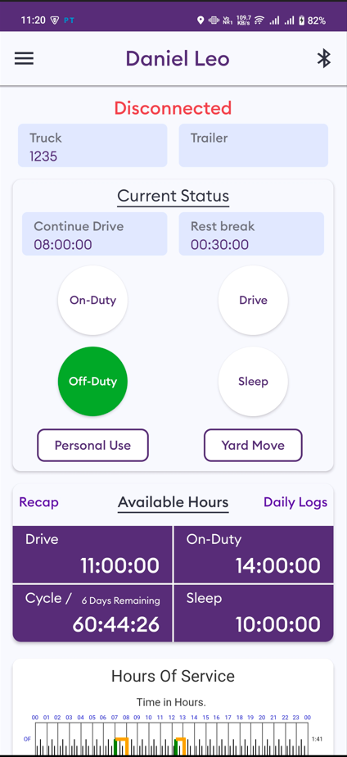
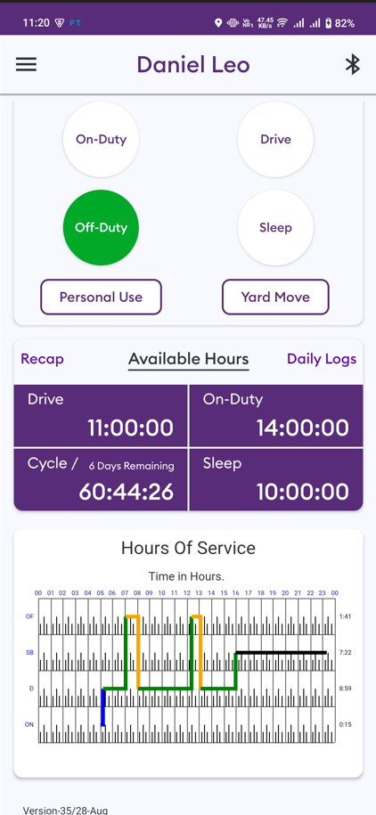
Duty Status
Set duty status with click on status button.easy to use interface allow driver to spend less time doing paperwork and more time driving.
Current Status
Current duty status is always displayed on dashboard and available hours.
Change Status
Tap the status circle get your current location and add a note if necessary and
Press submit button.
Personal/Yard
Personal use offDuty and Yard Move onDuty status be configured and allowed by a fleet manager.
Available Hours
Available hours always displayed on the main screen for On-Drive , On-Duty , Off-Duty and Sleep.

Slide 6
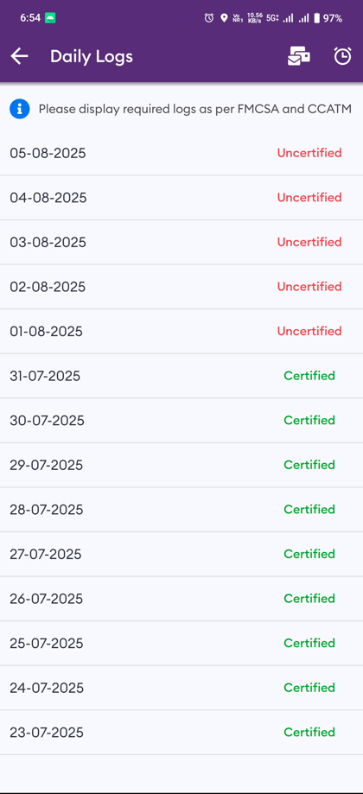
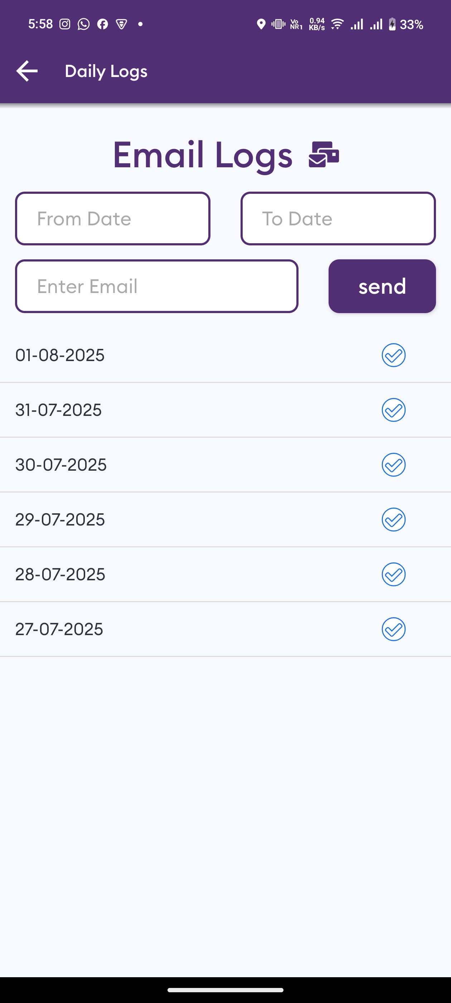
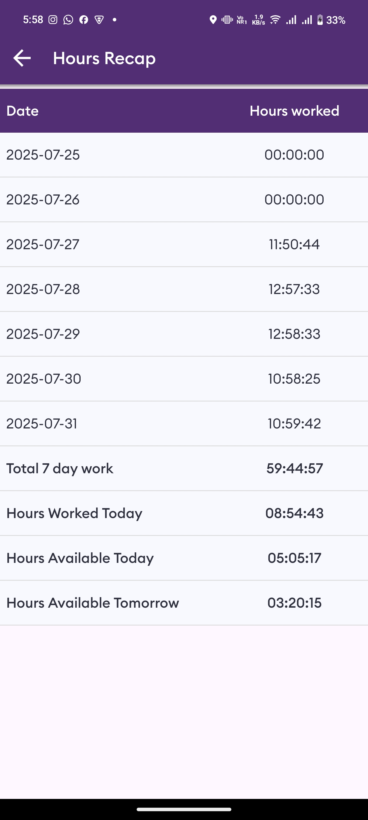
Logs
Managing logs has never been easier
Logs History
Check past and current day logs.
Email Logs
Send logos into mail by select date from calendar.
Hours Recap
Check weekly working time ,remaining time for today and tomorrow.
Tap “Certify” and sign your log when your shift ends
Certify Log

Slide 7
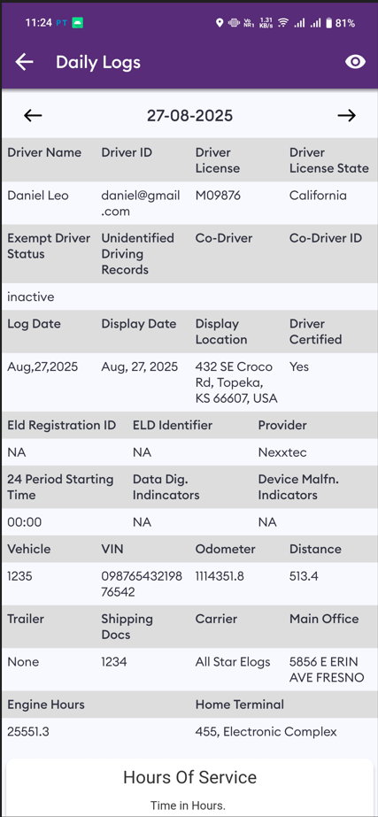
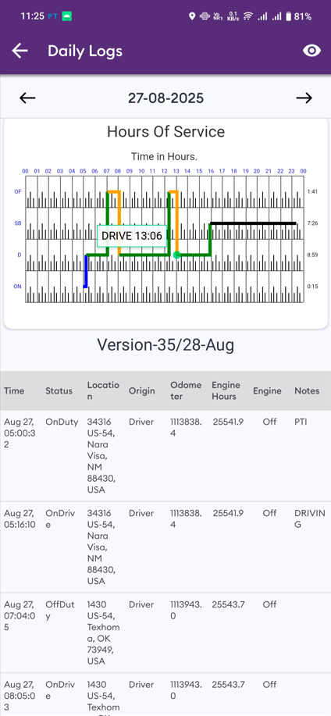
Log Details
Log graph and events
Logs Events
Check driver log events ,duty status and violation.
Email Date
Click on a left right arrow in the top to change a date.
Hours Graph
Check driver Hours of Service graph.
View past log & violation if any.
Certify History

Slide 8
Log Details
Log graph and events
Log Events
Check driver log events ,duty status and violation.
Log Date
Click on a left right arrow in the top to change a date.
Log Graph
Check driver Hours of Service graph.
Log History
View past log & violation if any.

Slide 9
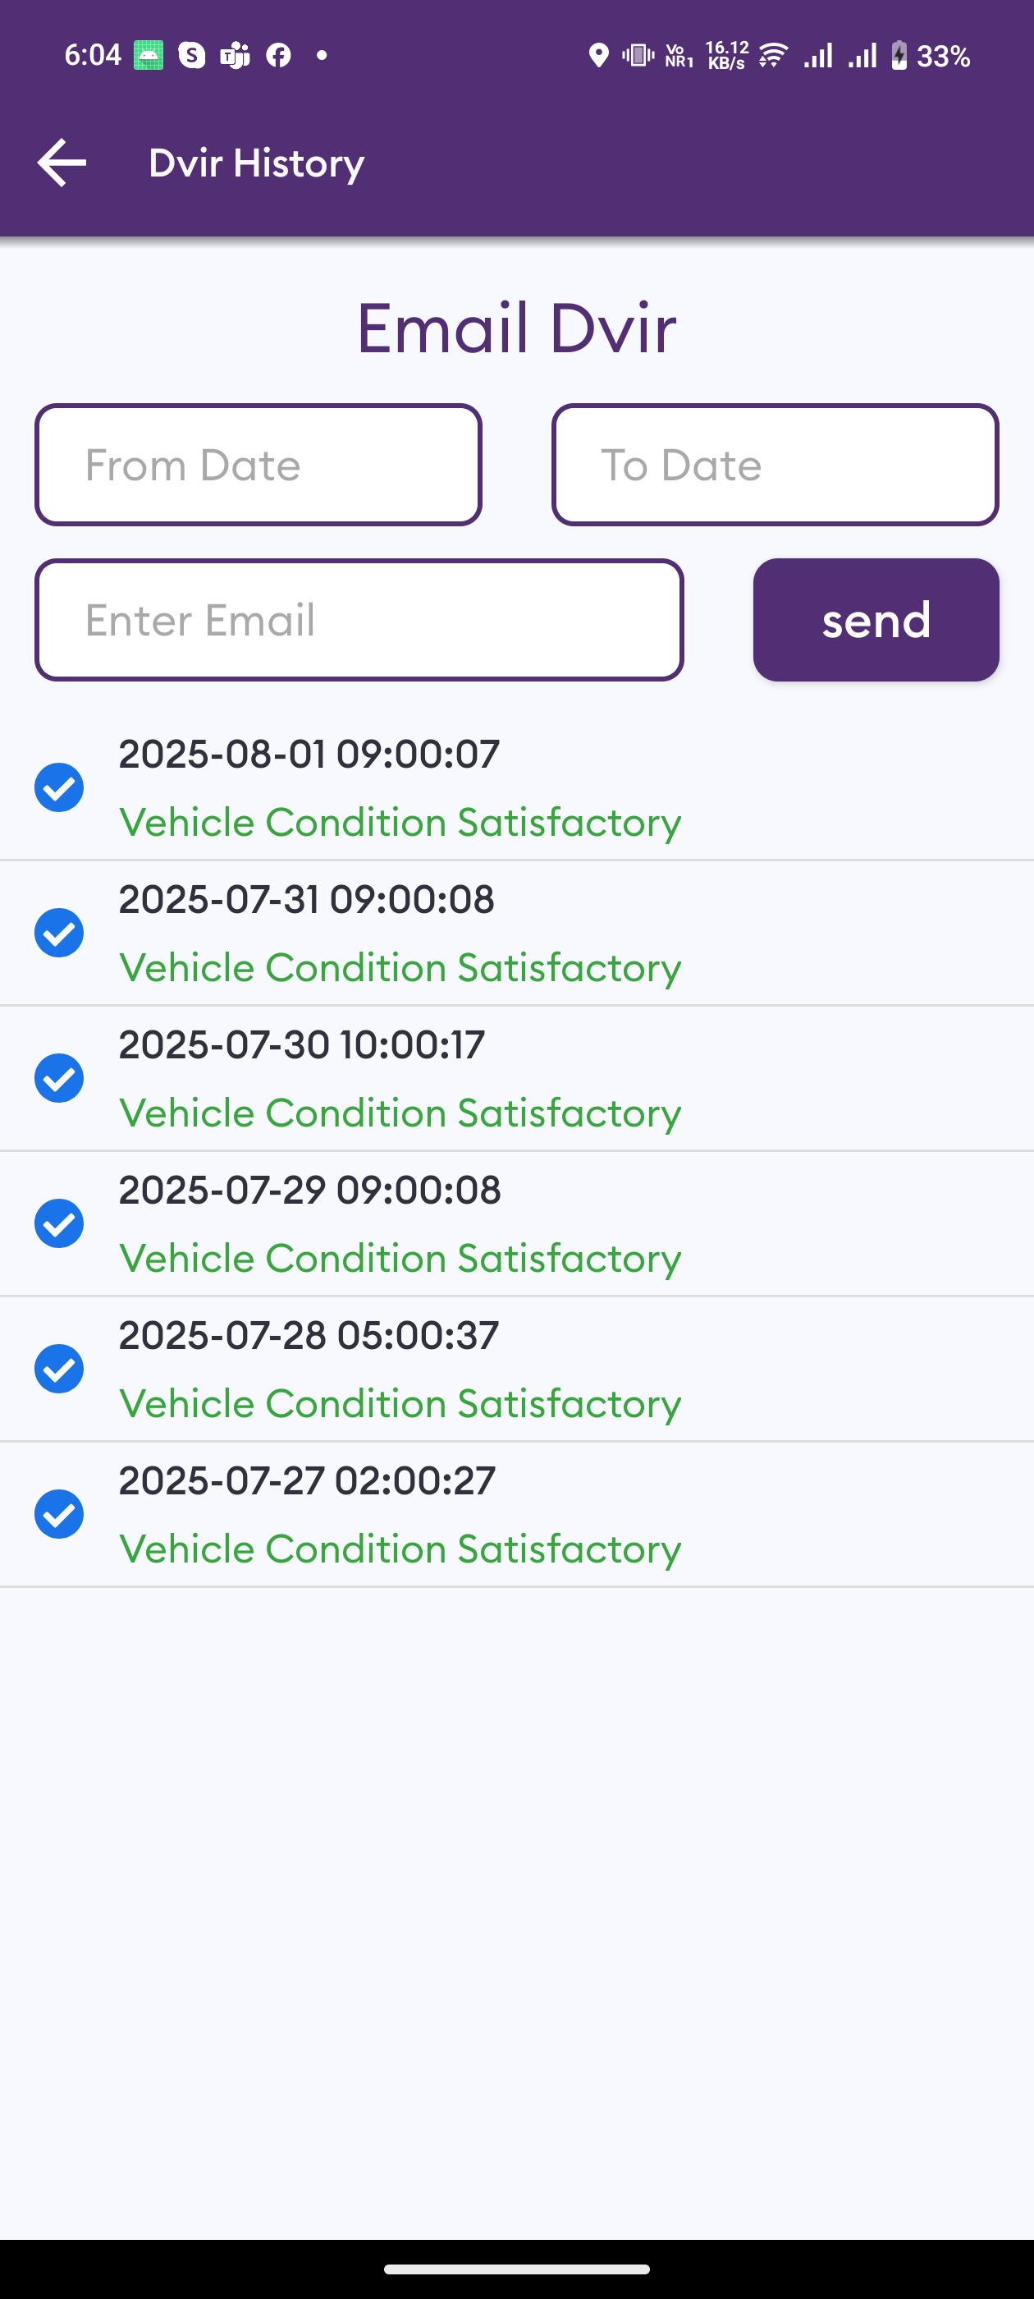
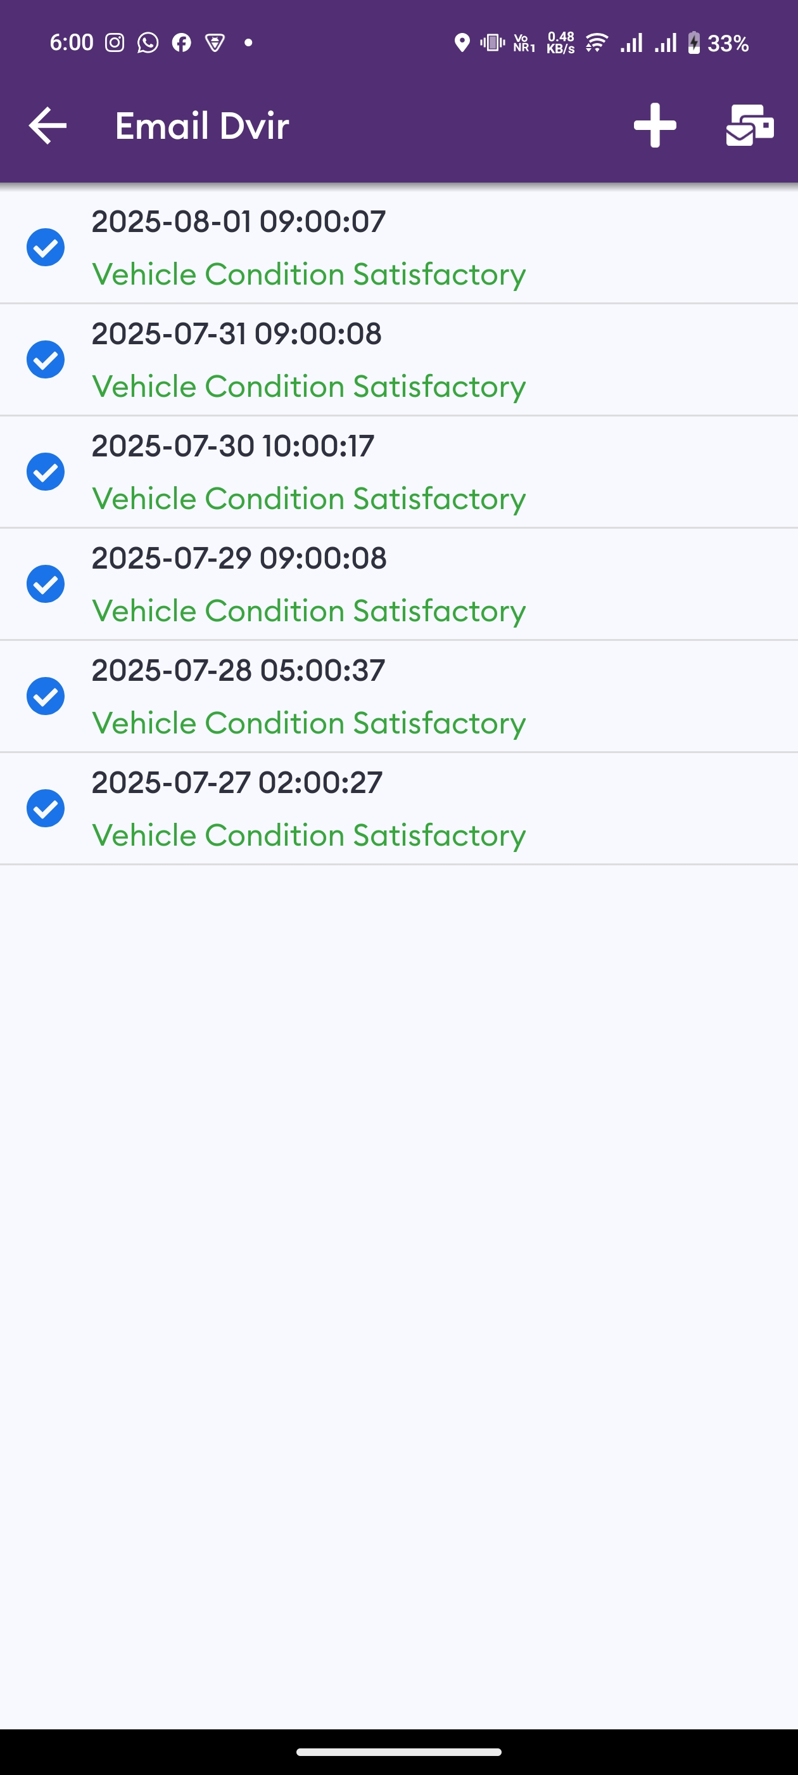
DVIRs
Paper-free DVIRs save time for drivers
Add Dvir
Add pre-trip or post trip inspection report.
Defects
Select the defect (if any) from the list and sign DVIR
Email DVIR
Email DVIR to select from and to date to any email id.
DVIR History
Review past DVIRs to prevents compliance errors.

Slide 10
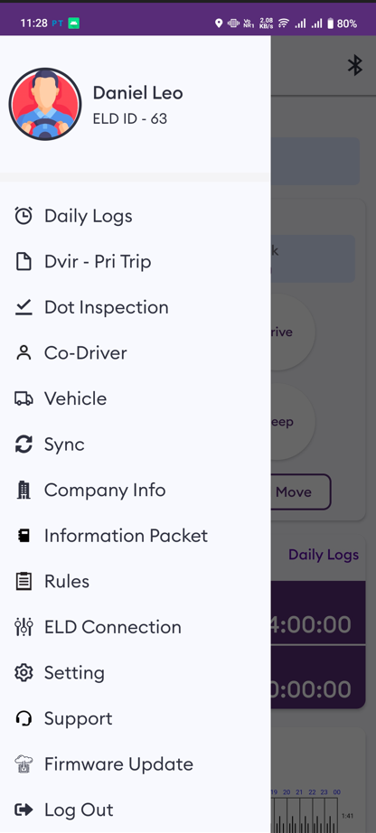
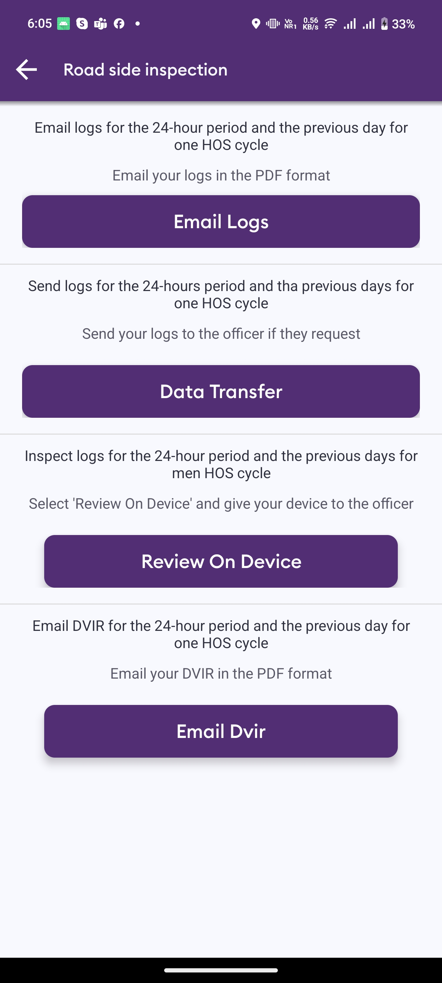
Easy to use & to Navigate
Driver-friendly ELD Logbook interface
Easy-to-Navigate
& Simple menu
Roadside
Inspection
Working hours calculation

Slide 11
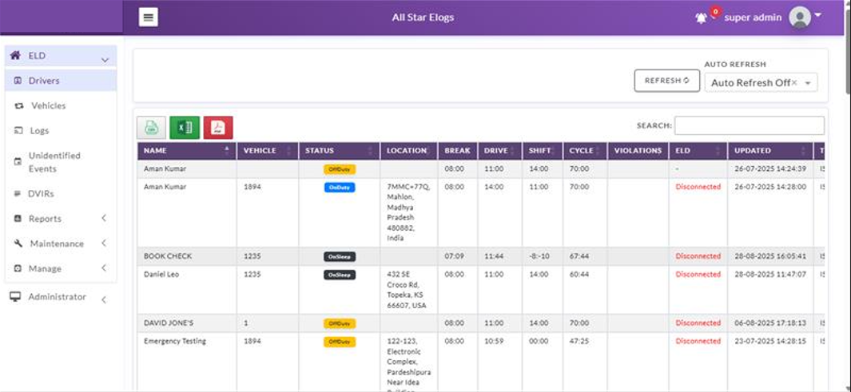
Driver Log Dashboard
Make sure your driver stay compliant and productive
Current status
View current status and location of your
Driver .
Real-Time Hours
View real-time hours to avoid violation and regulatory fines.
Violations
Monitor violations in real time and
Compliance risk.

Slide 12
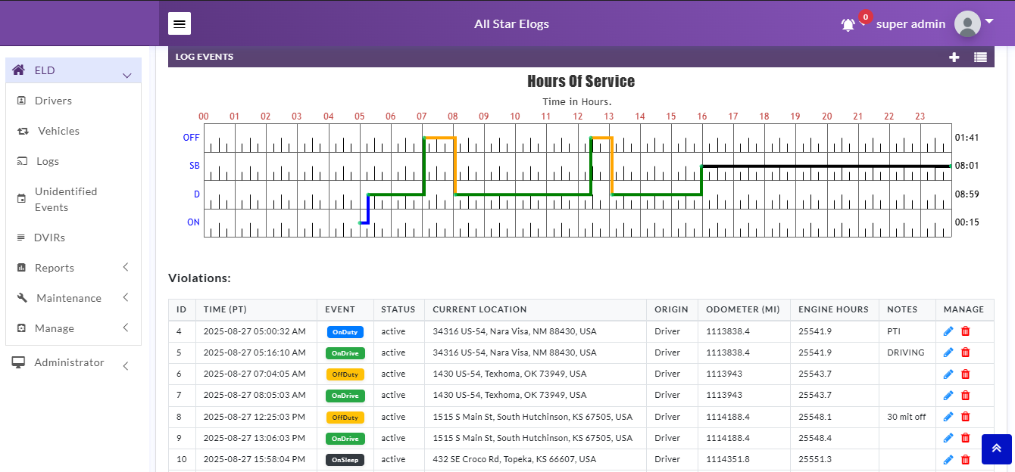
Driver Details
Everything about the driver in one place
Hours of Service
View current status and real-time hours. Available and reset hours are calculated automatically
Driver Logs
View current log graph grid and last 14 logs. Click on a log to see log details. Click “More” to view historical logs.
Violatuions & Errors
Monitor violations and errors in real time. View past violations and mitigate compliance risks
Details
View driver contact information, current or last known vehicle and location

Slide 13
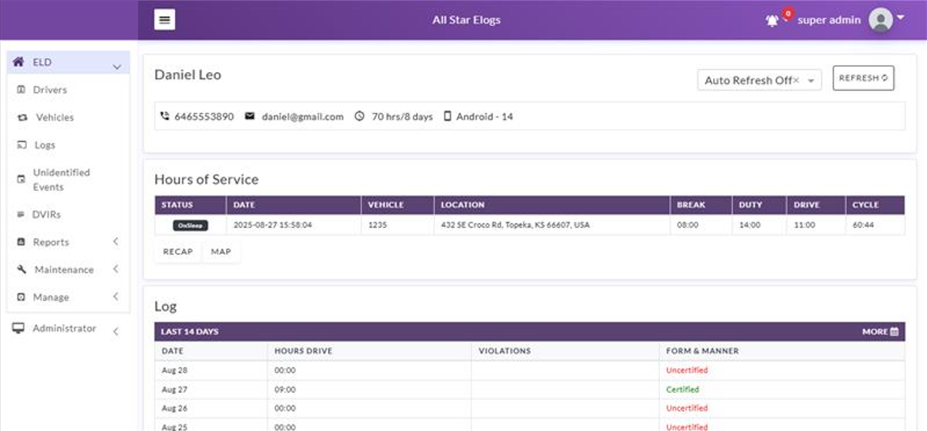
Logs
Make sure your drivers stay compliant and productive
View Logs
View all current and past logs up to six months
Filter
Filter by date or driver
Violations
Monitor violations in real time

Slide 14
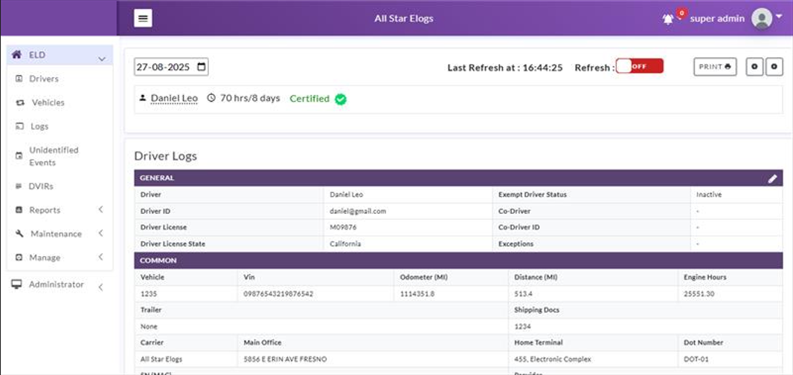
Log Details
Log form and events
Log Form
Form and manner errors are displayed automatically
Vehicles & Trailers
View vehicle & trailer information. Check shipping documents numbers
Log Events
Check log events. Click on event to suggest an edit. Click “+” to suggest to add an event
Log Date
Click on a calendar in the top right corner to change a date or click “<->” to switch between logs

